Slide 1
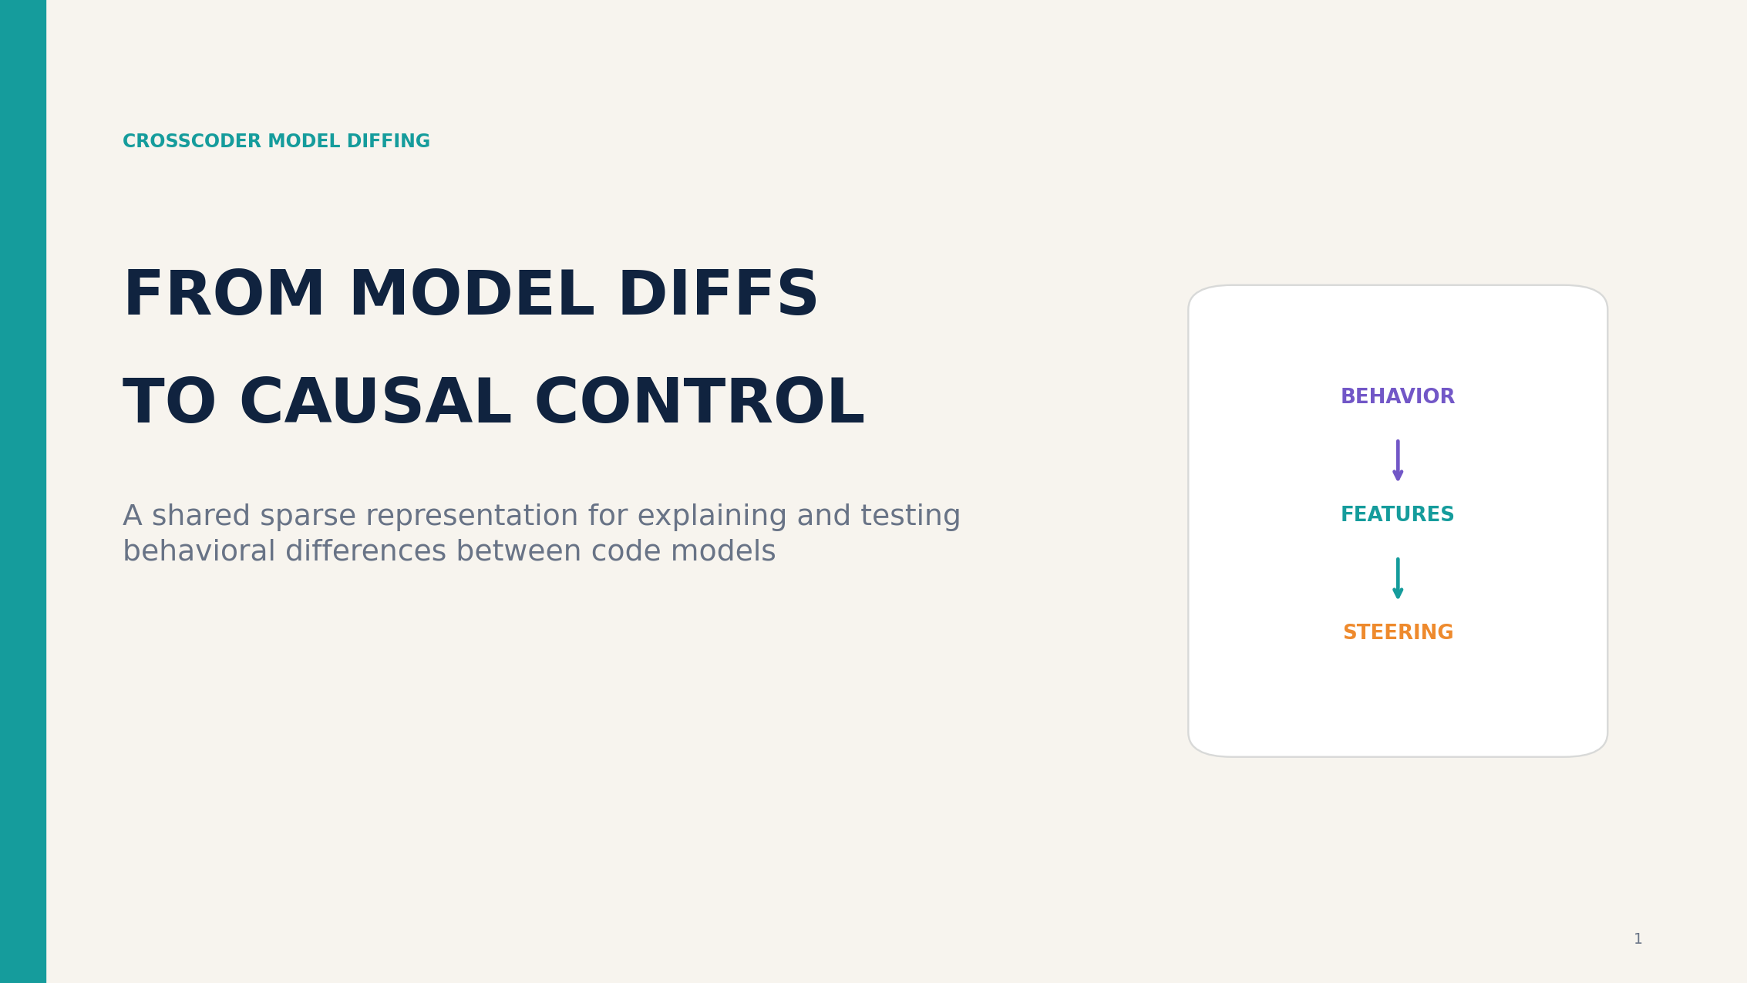

Slide 2
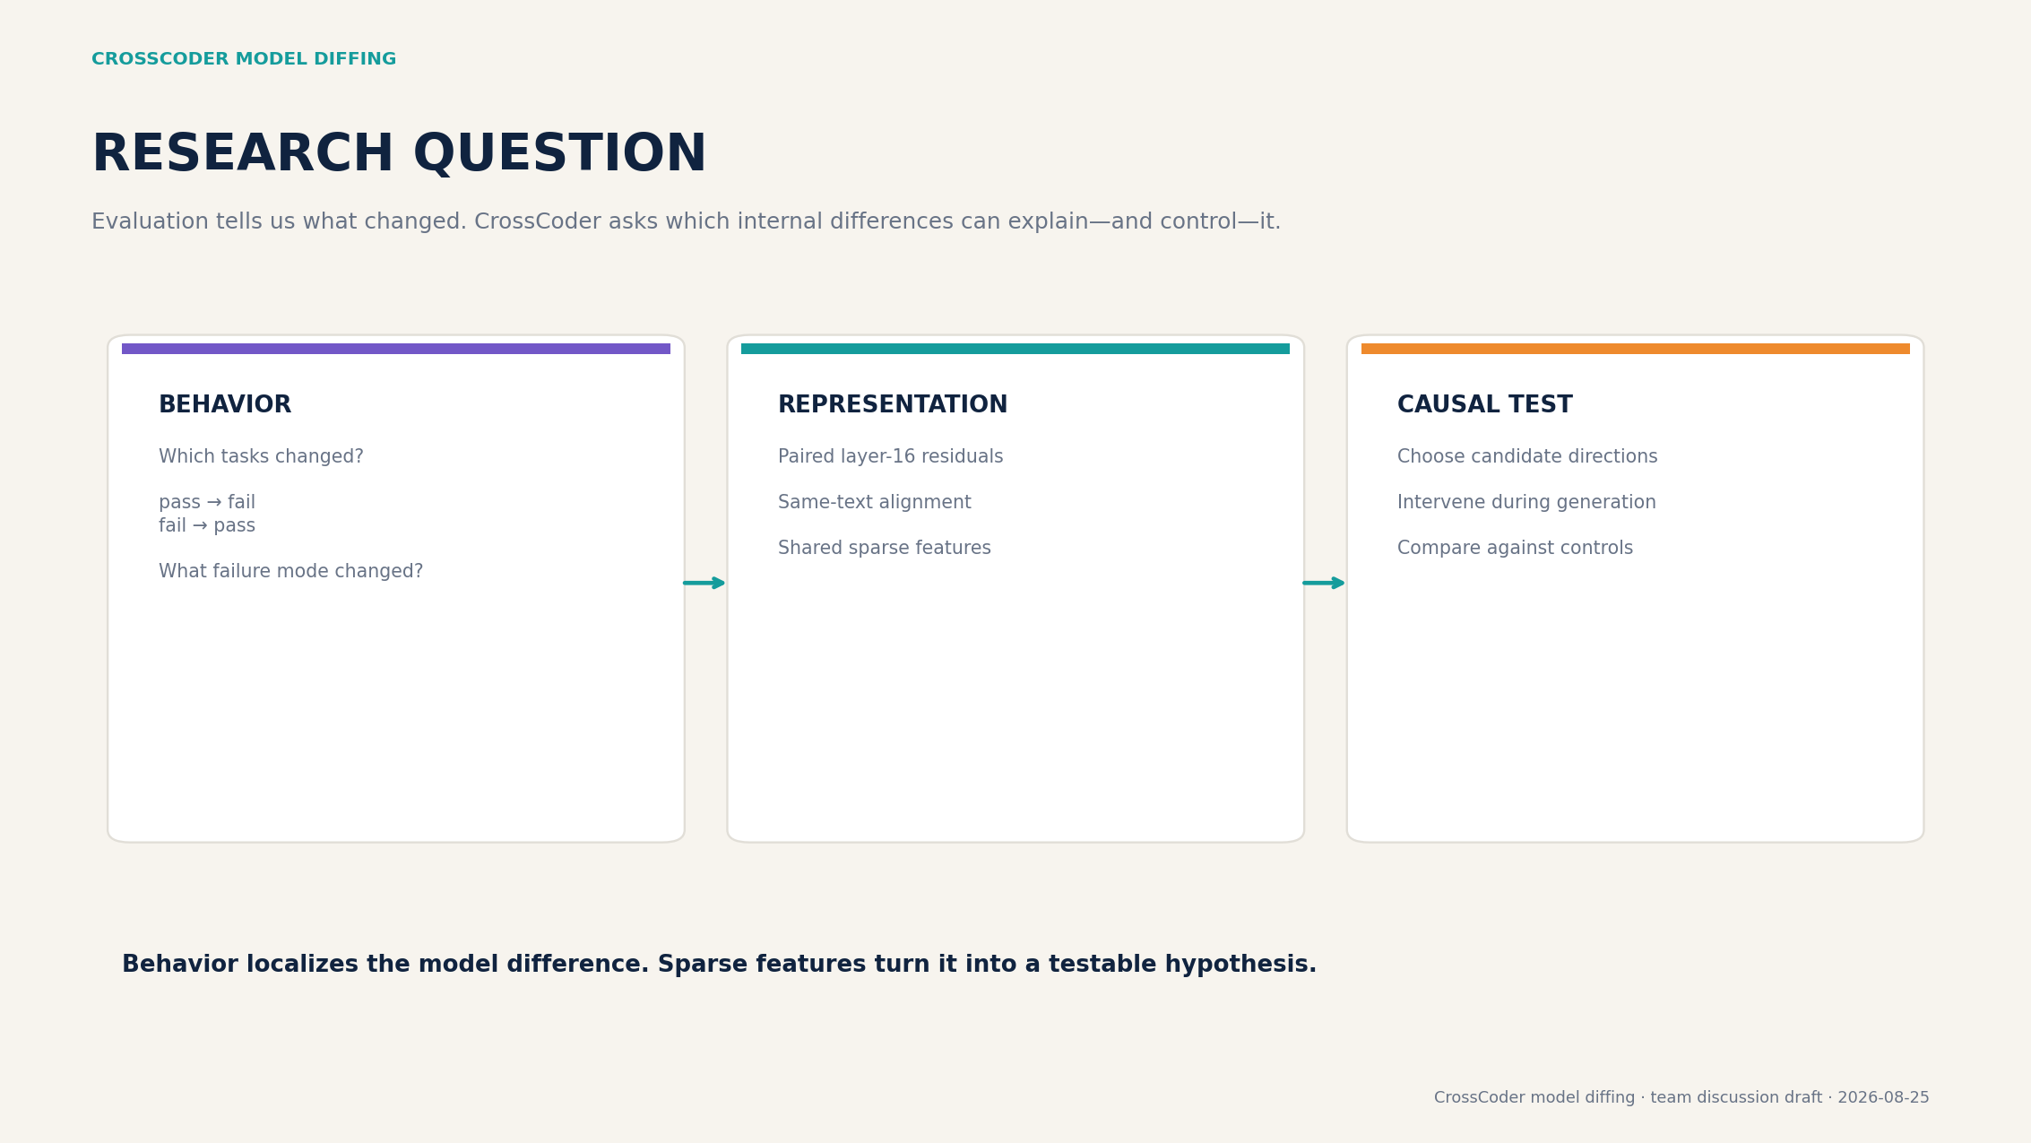

Slide 3
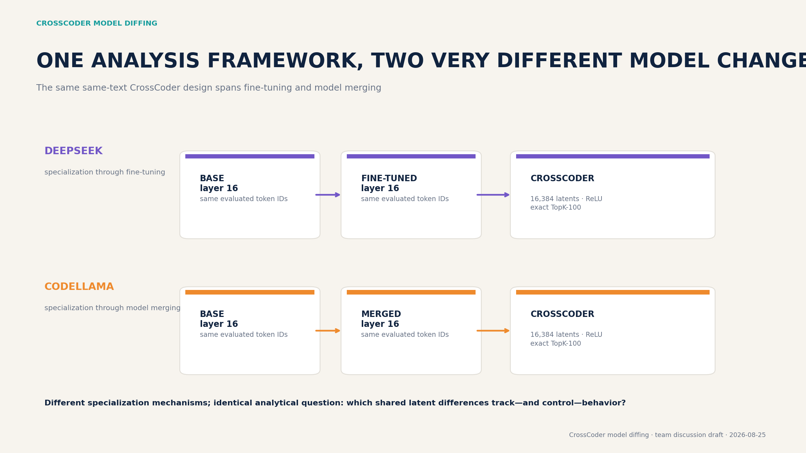

Slide 4
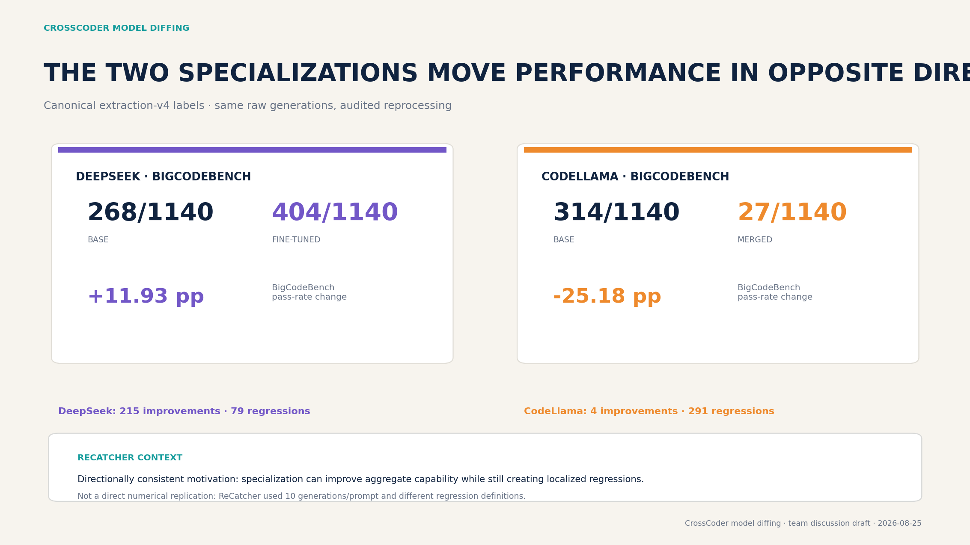

Slide 5
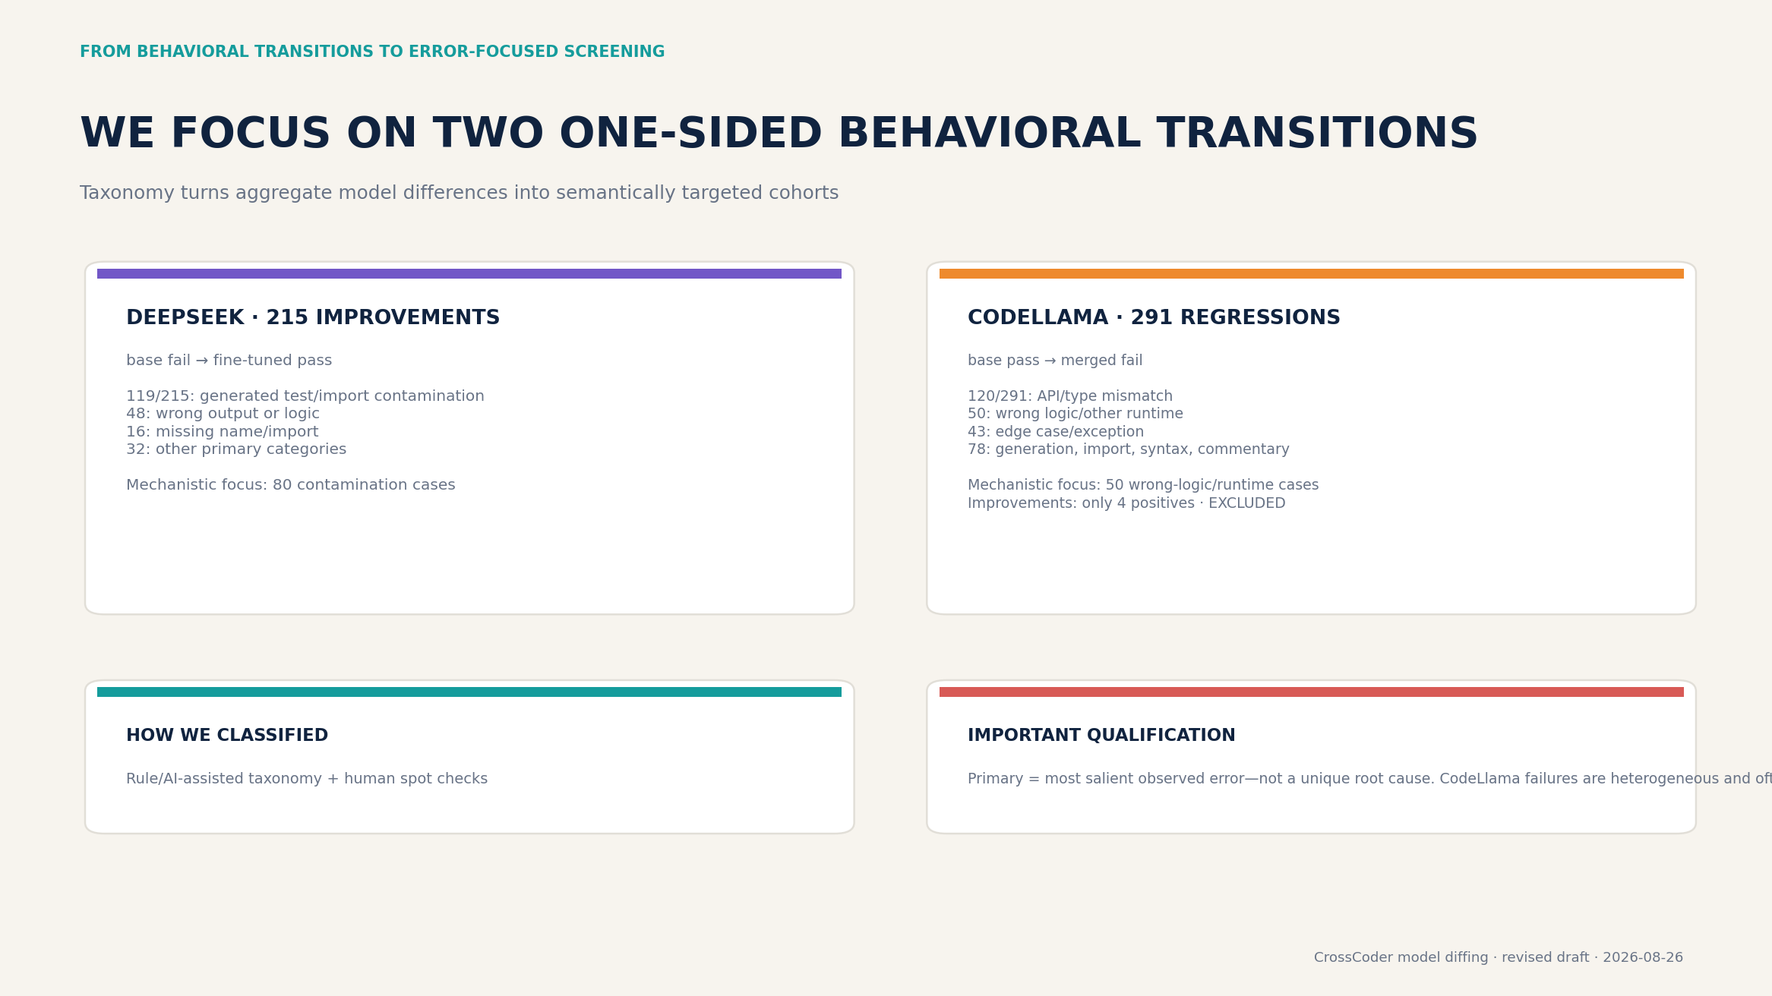

Slide 6
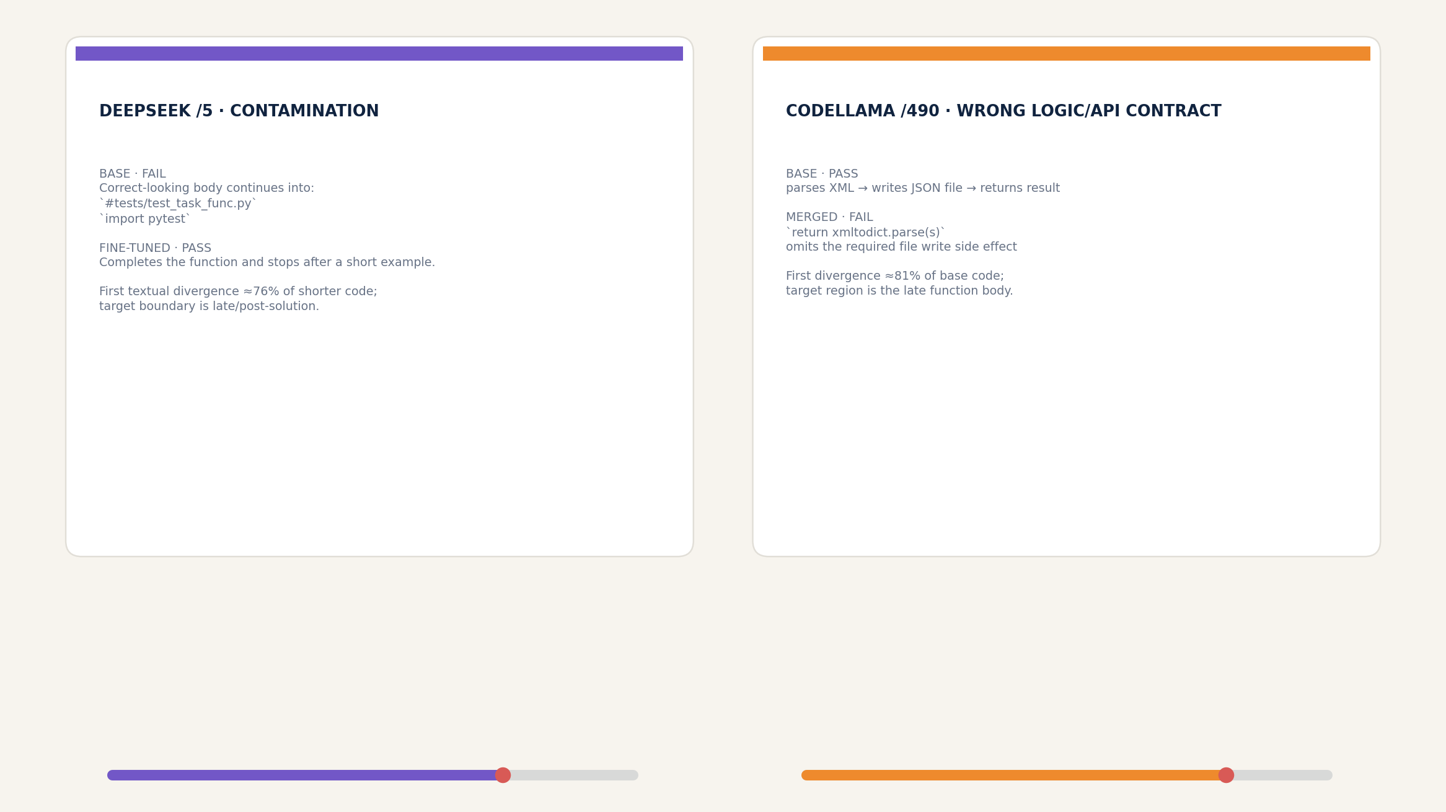

Slide 7
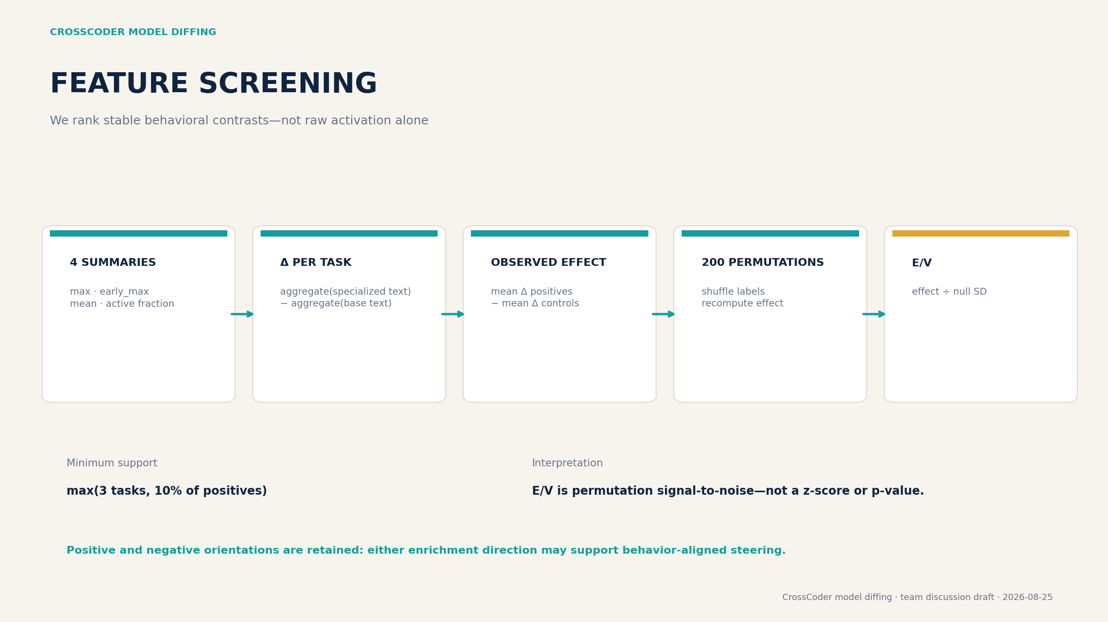

Slide 8
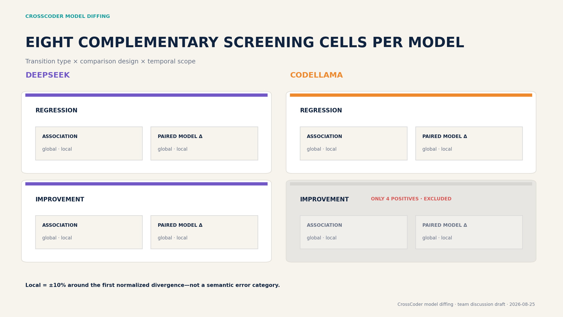

Slide 9
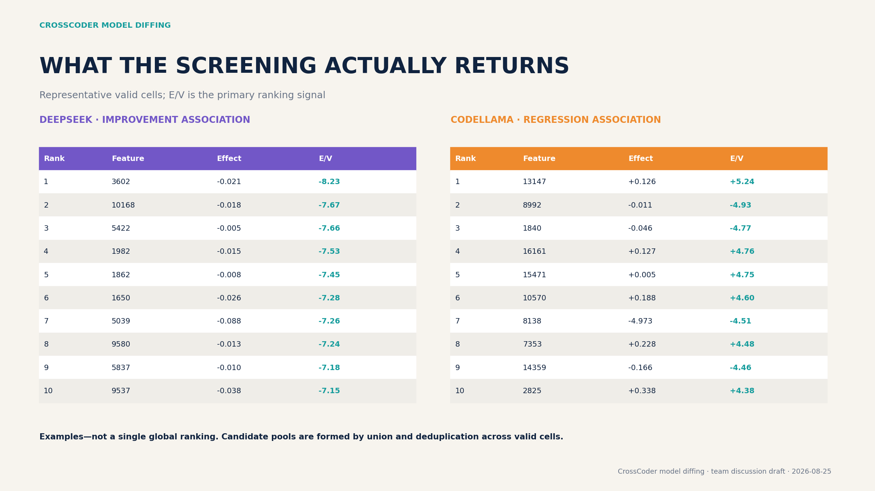

Slide 10
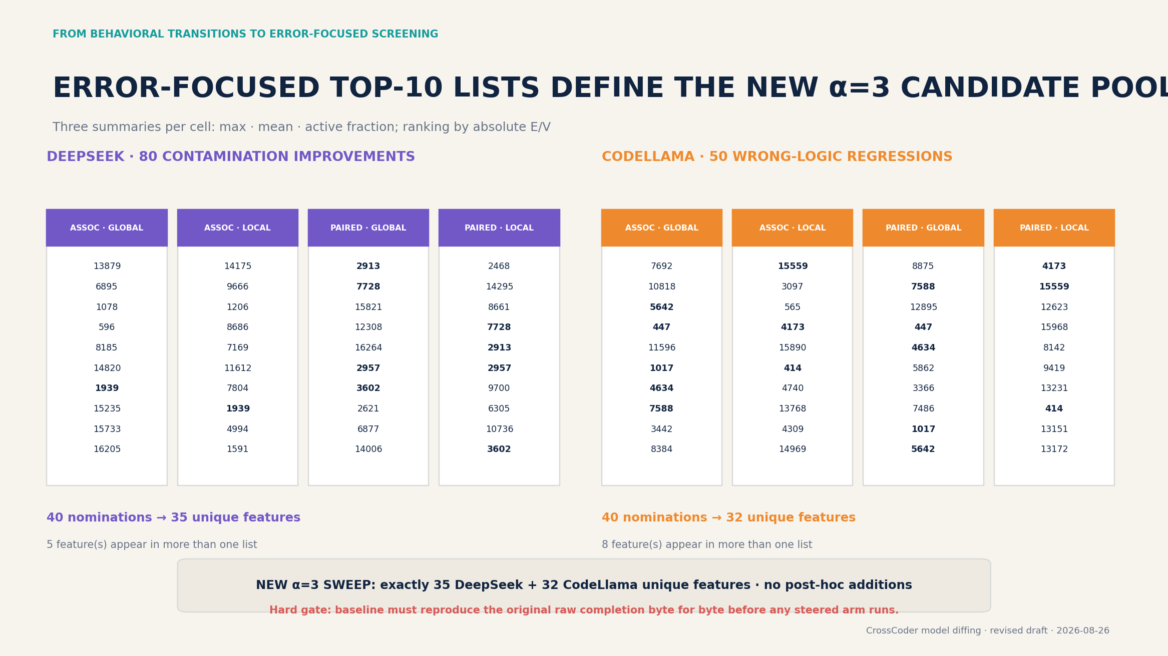

Slide 11
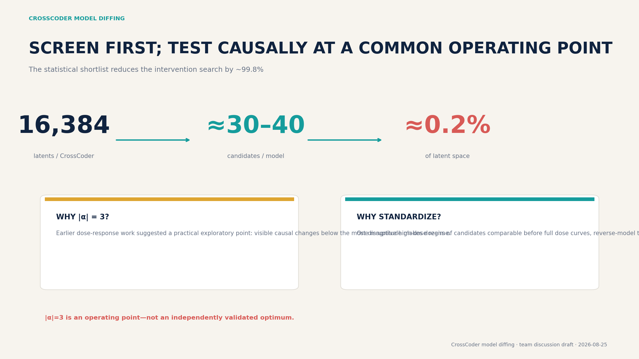

Slide 12
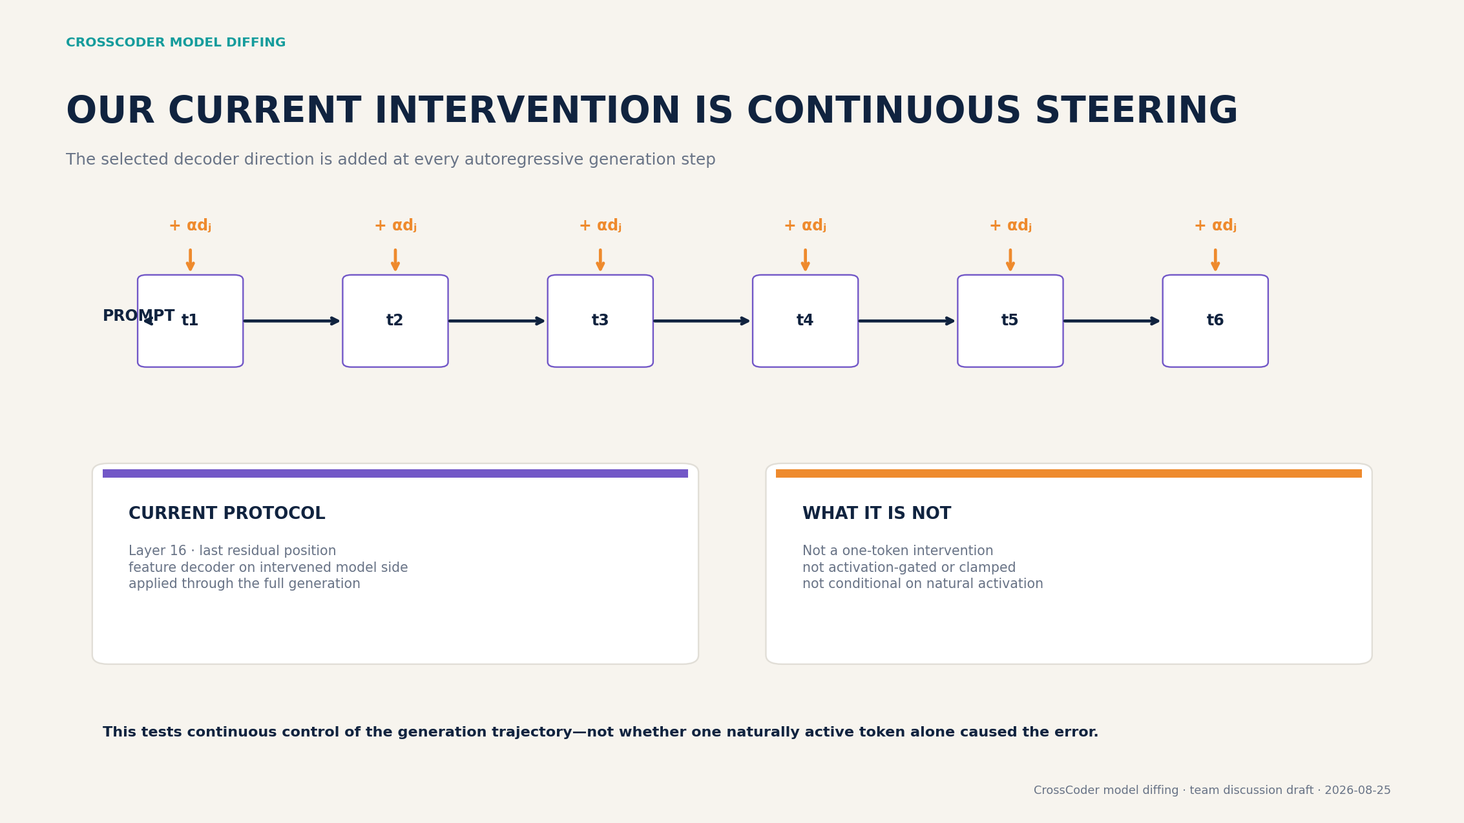

Slide 13
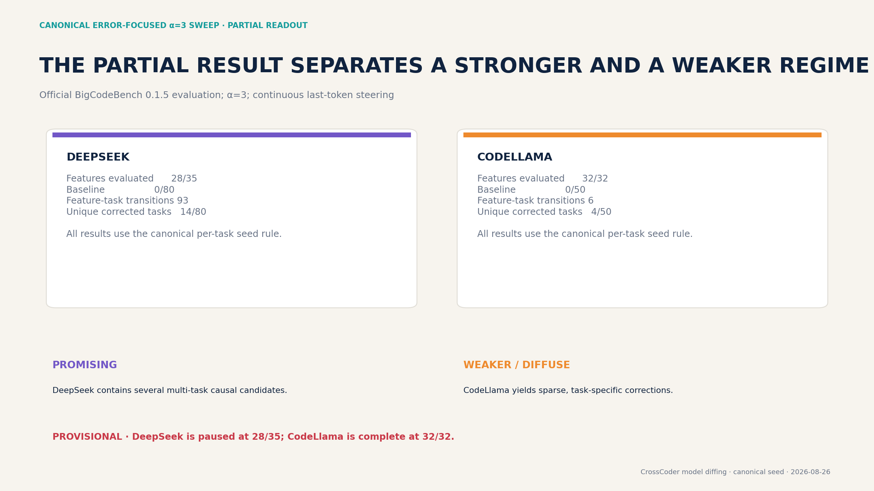

Slide 14
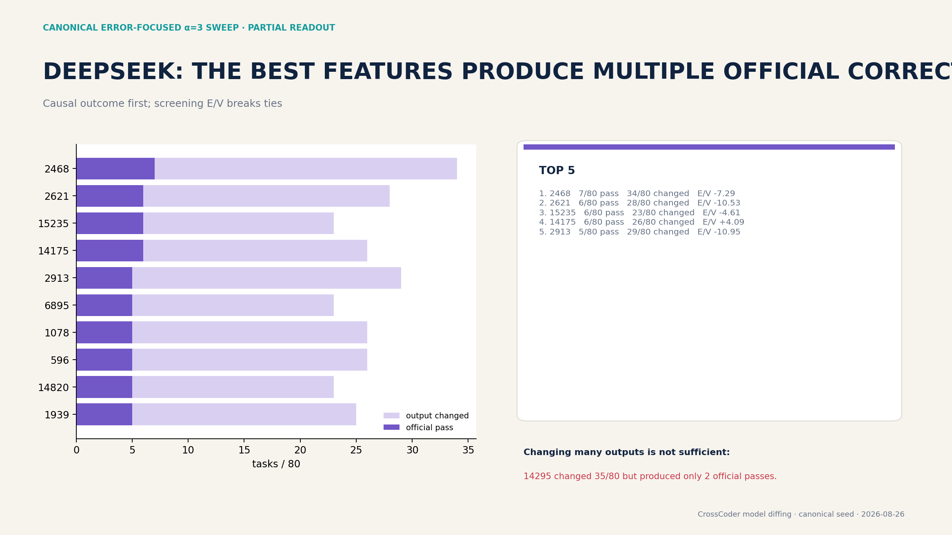

Slide 15
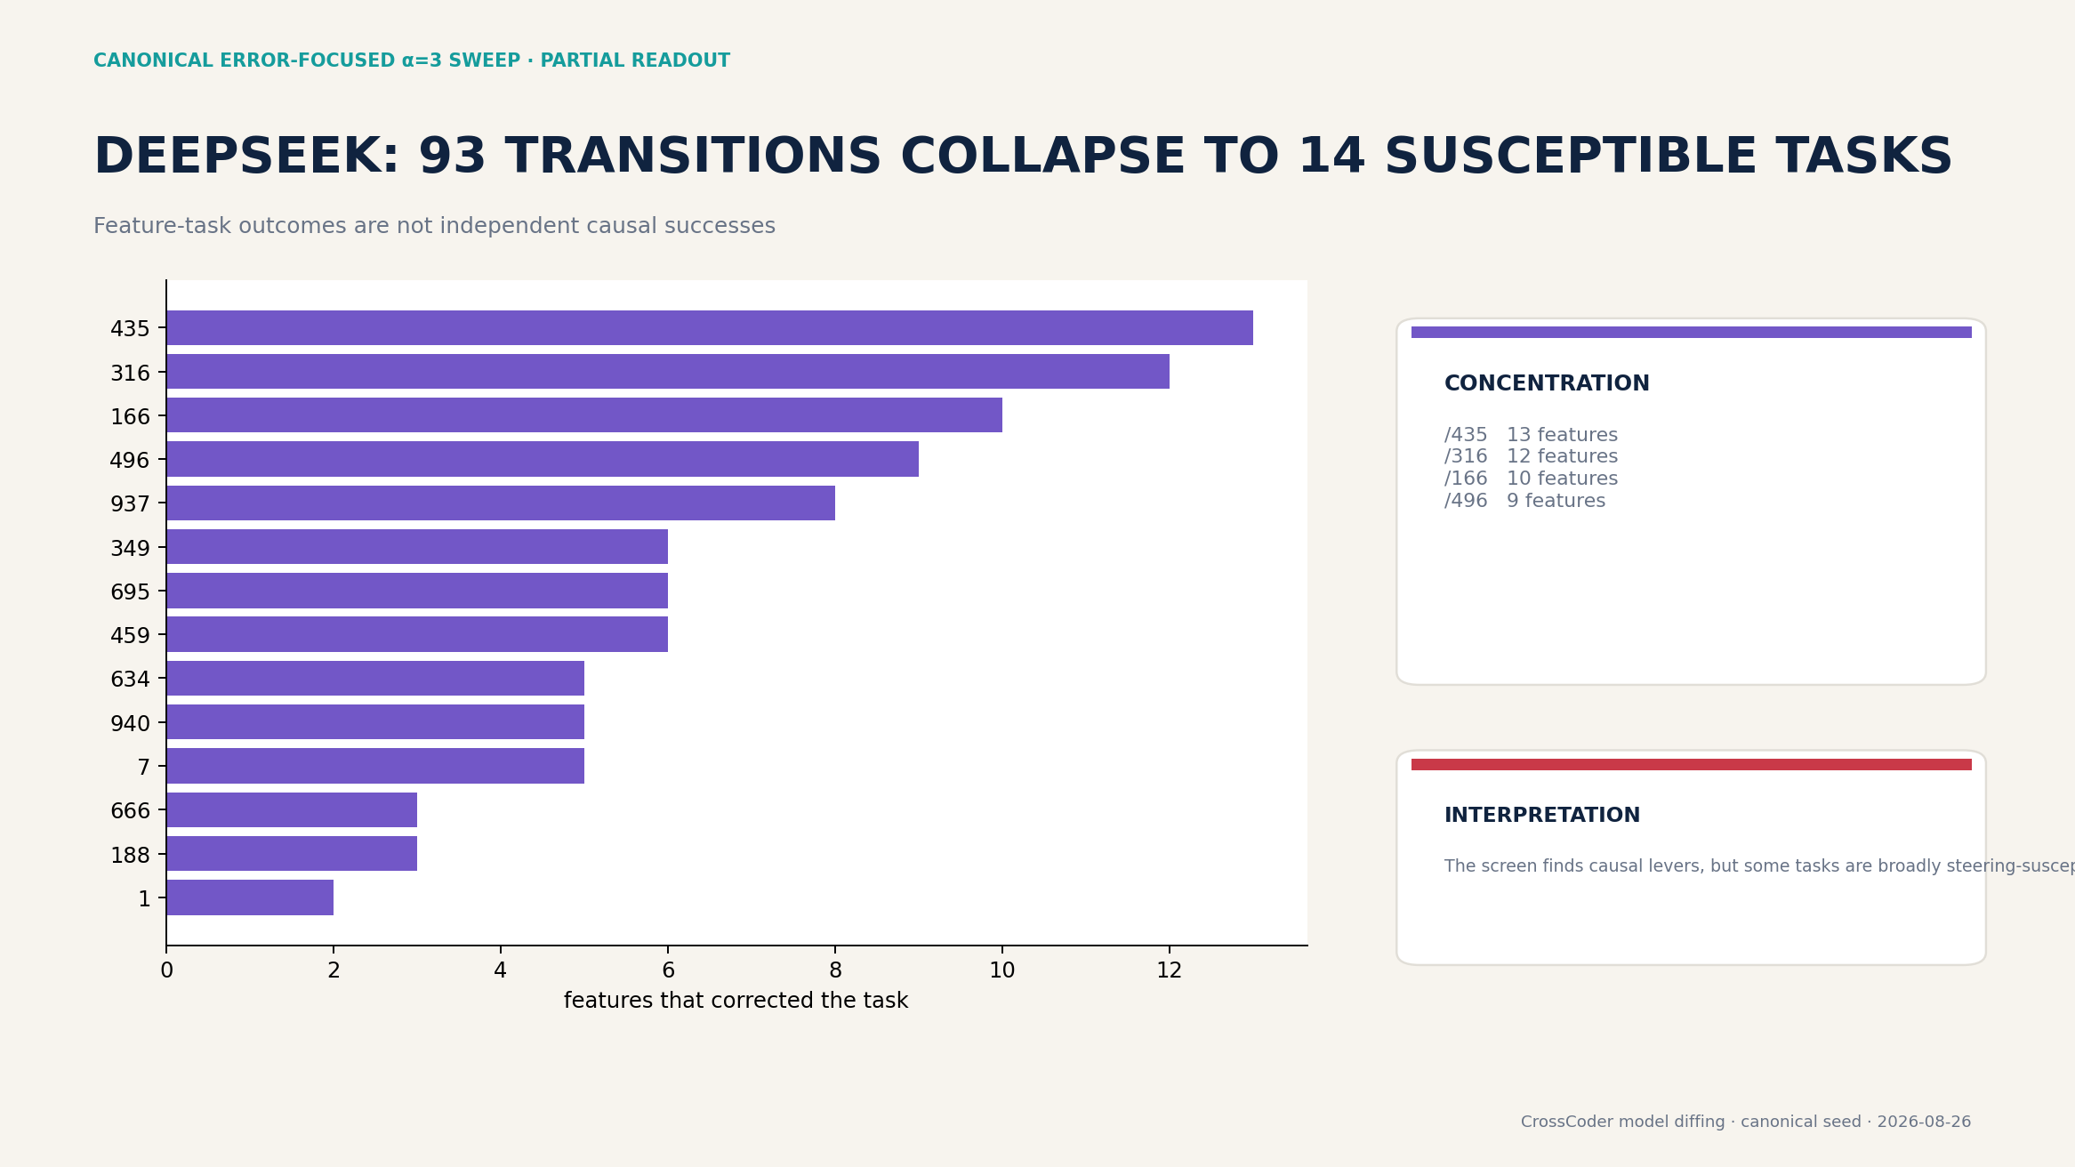

Slide 16
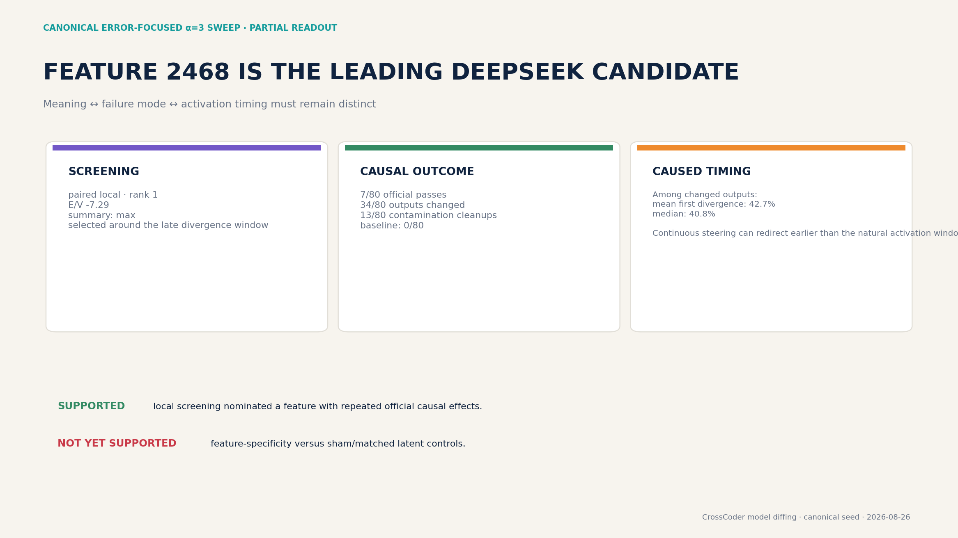

Slide 17
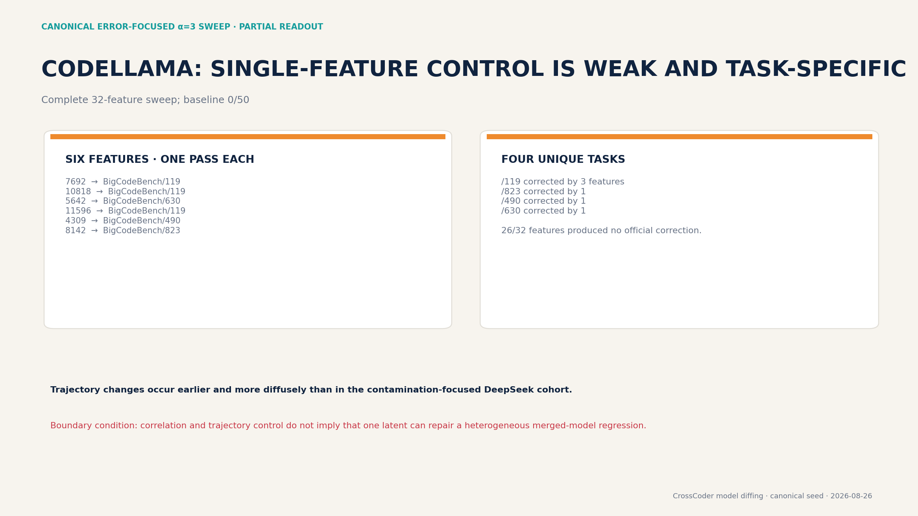

Slide 18
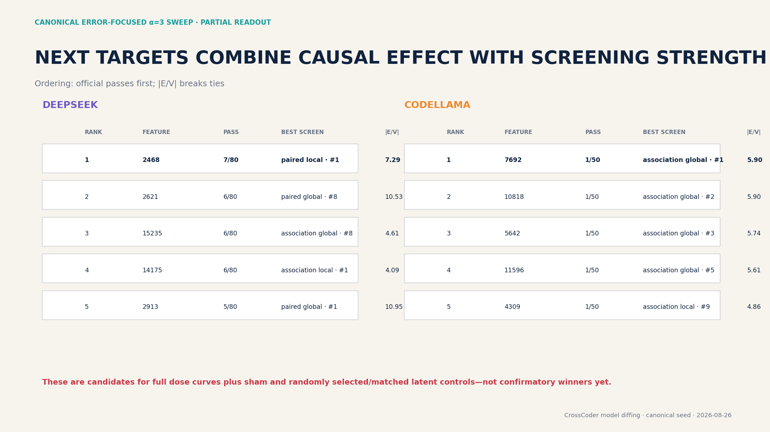

Slide 19
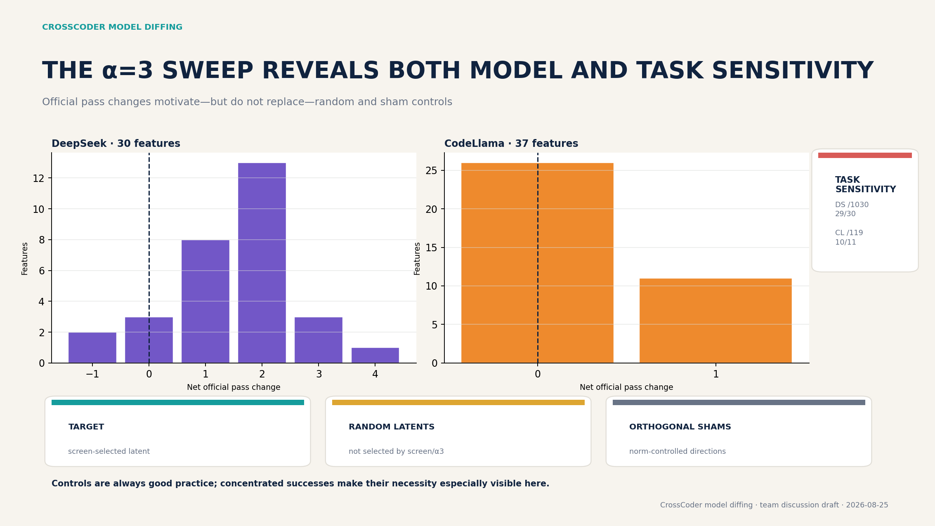
OUTDATED · superseded candidate pool and/or non-canonical seed

Slide 20
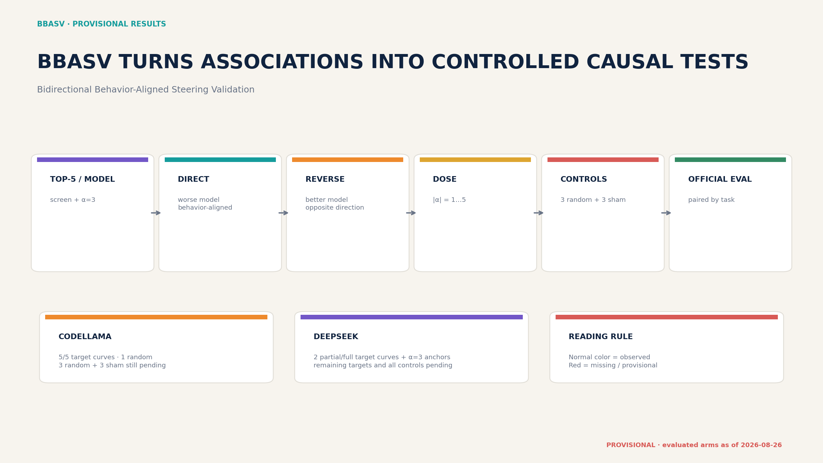
OUTDATED · superseded candidate pool and/or non-canonical seed

Slide 21
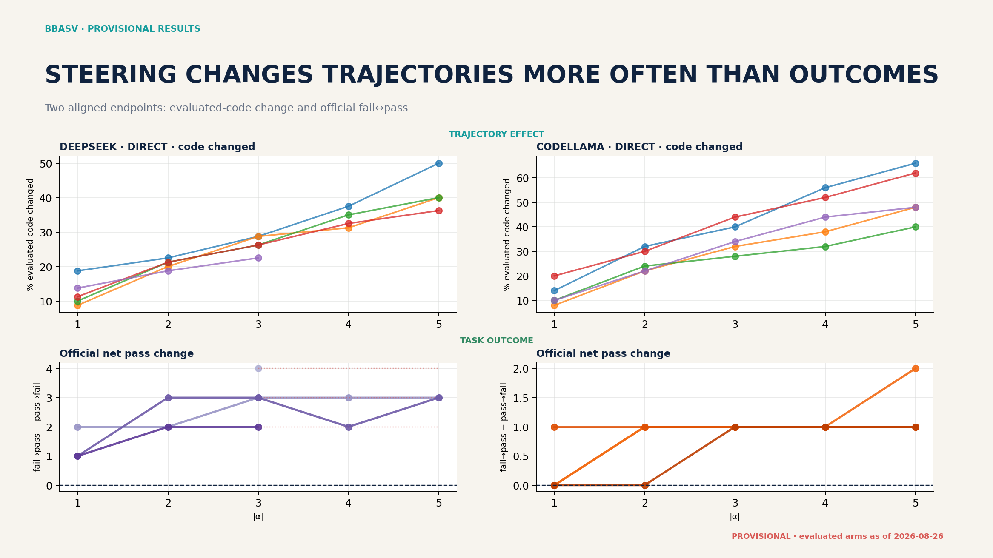
OUTDATED · superseded candidate pool and/or non-canonical seed

Slide 22
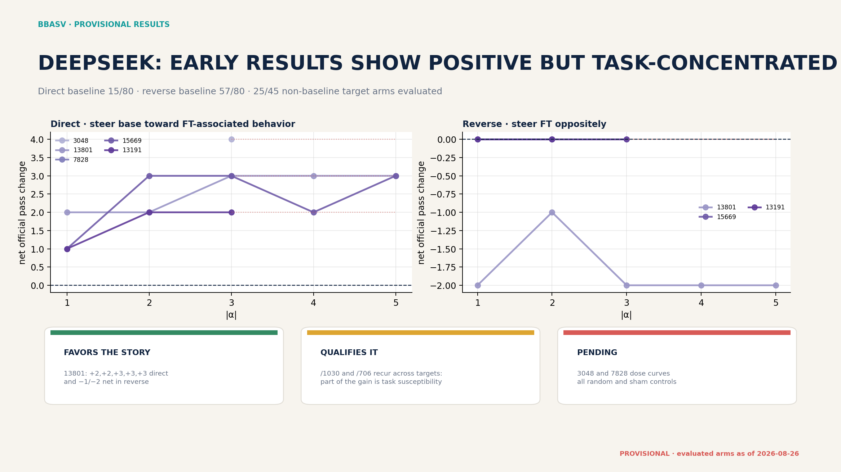
OUTDATED · superseded candidate pool and/or non-canonical seed

Slide 23
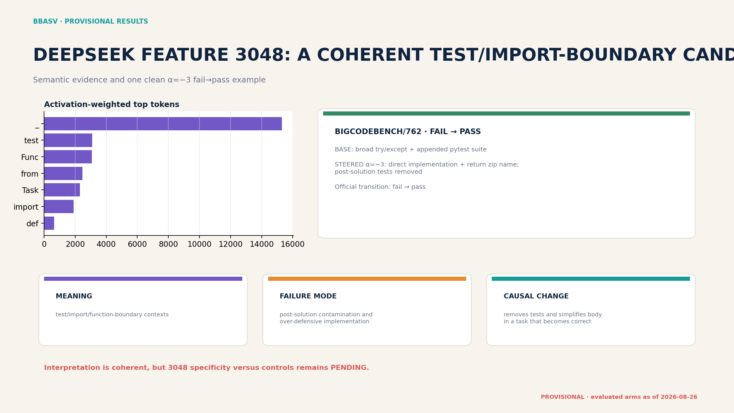
OUTDATED · superseded candidate pool and/or non-canonical seed

Slide 24
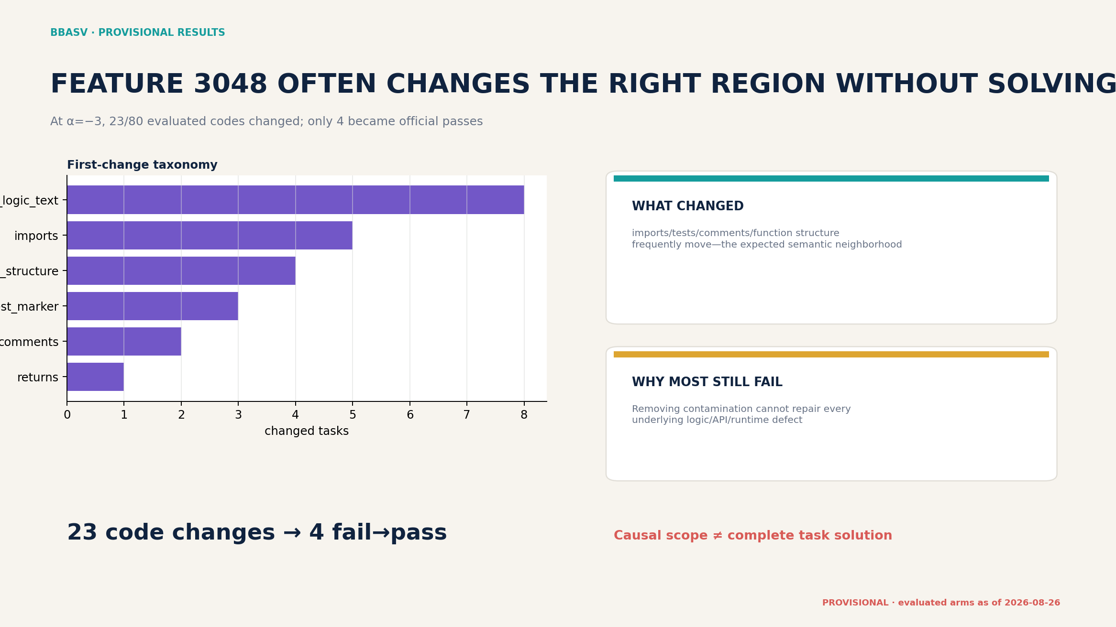
OUTDATED · superseded candidate pool and/or non-canonical seed

Slide 25
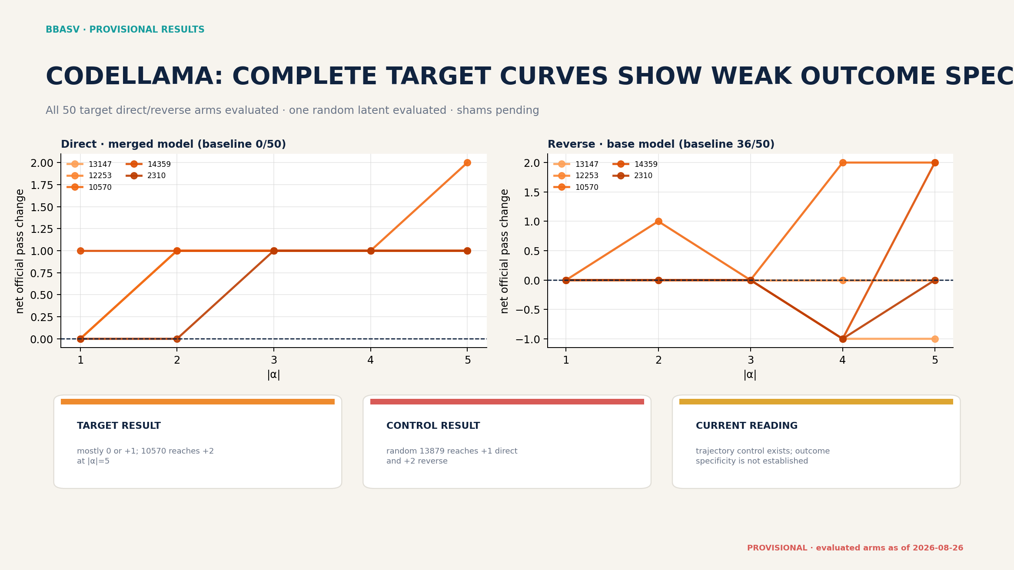
OUTDATED · superseded candidate pool and/or non-canonical seed

Slide 26
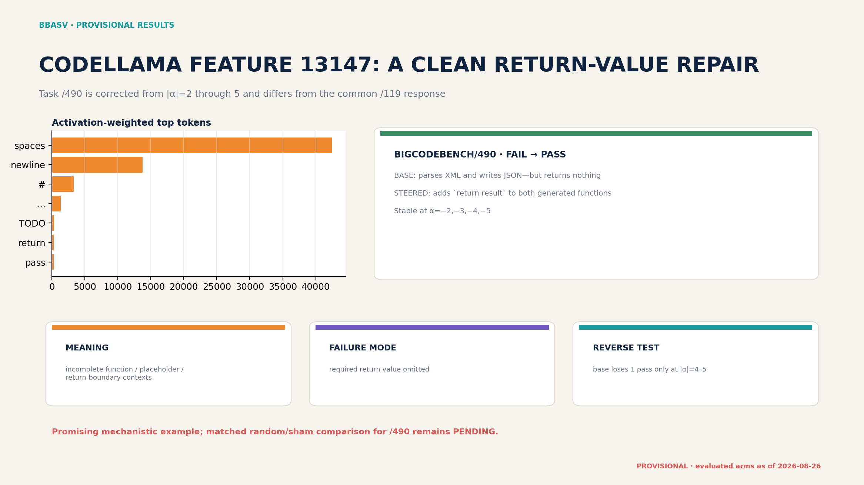
OUTDATED · superseded candidate pool and/or non-canonical seed

Slide 27
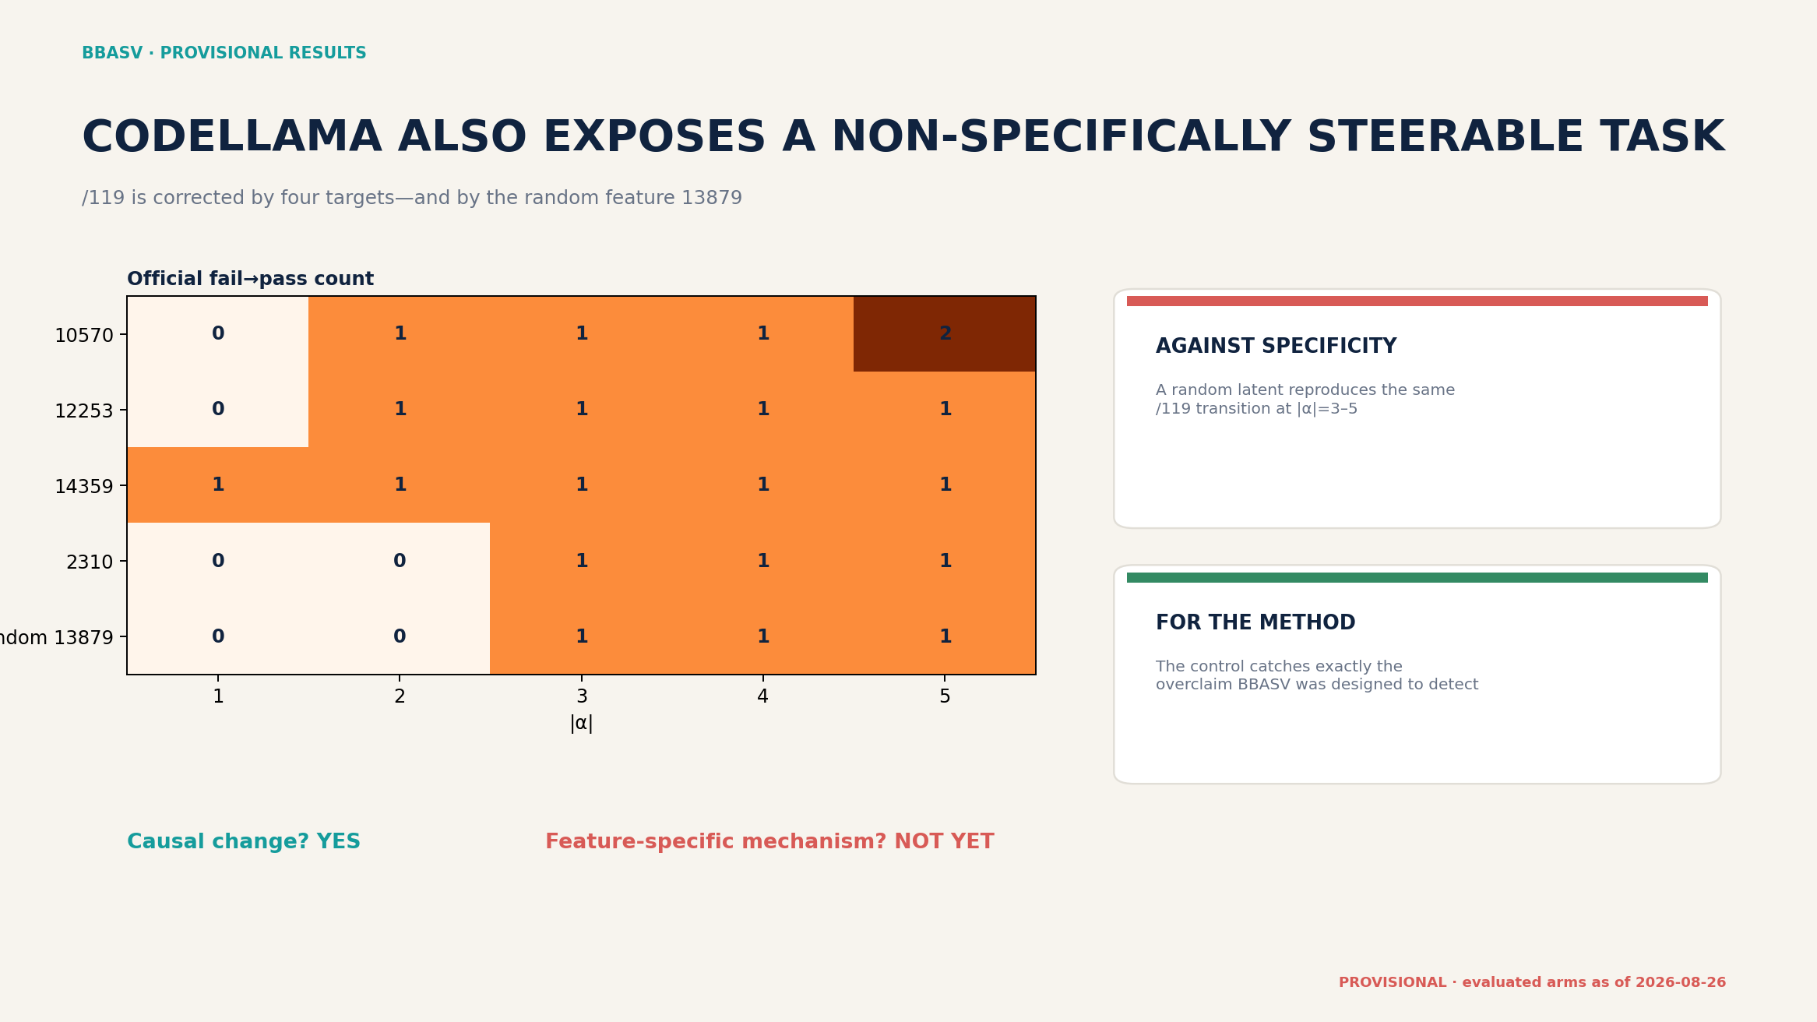
OUTDATED · superseded candidate pool and/or non-canonical seed

Slide 28
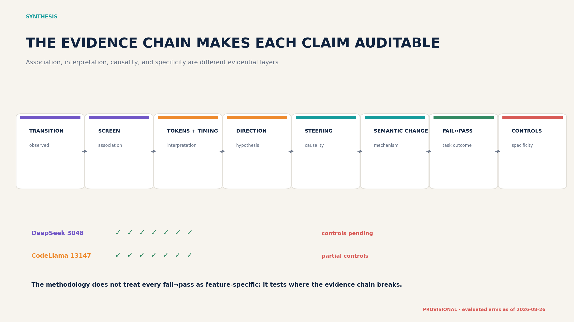
OUTDATED · superseded candidate pool and/or non-canonical seed

Slide 29
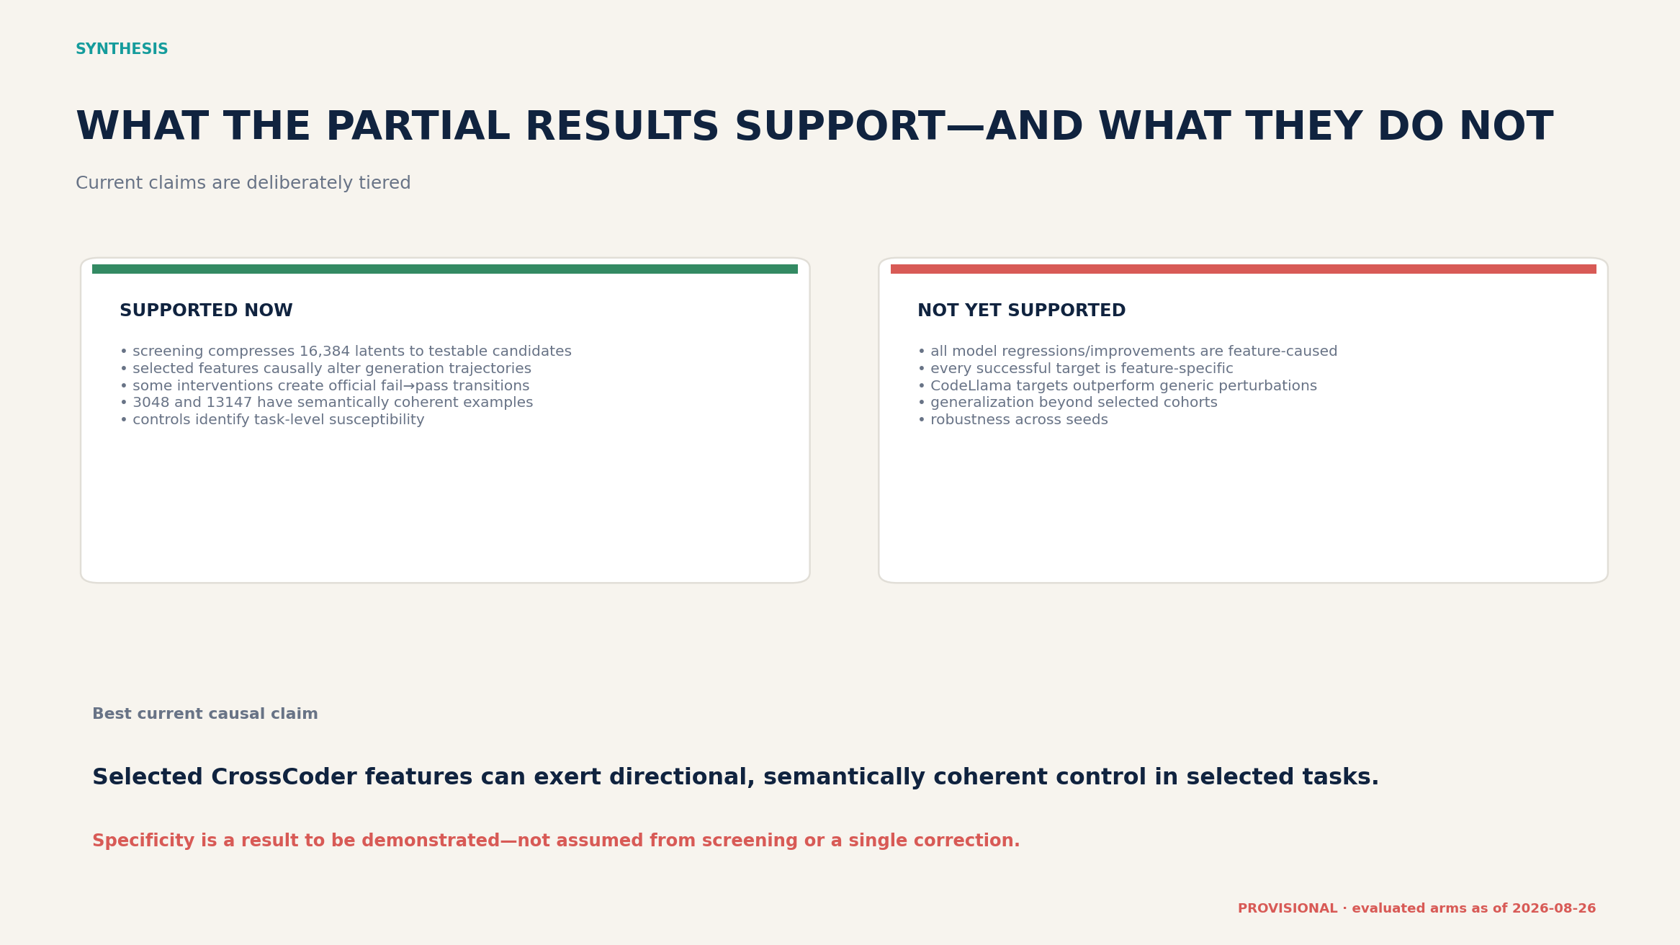
OUTDATED · superseded candidate pool and/or non-canonical seed

Slide 30
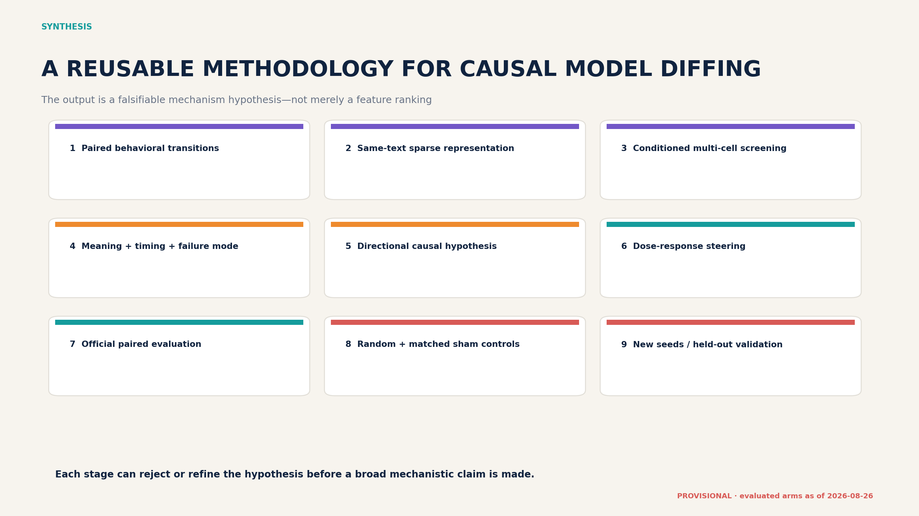
OUTDATED · superseded candidate pool and/or non-canonical seed

Slide 31
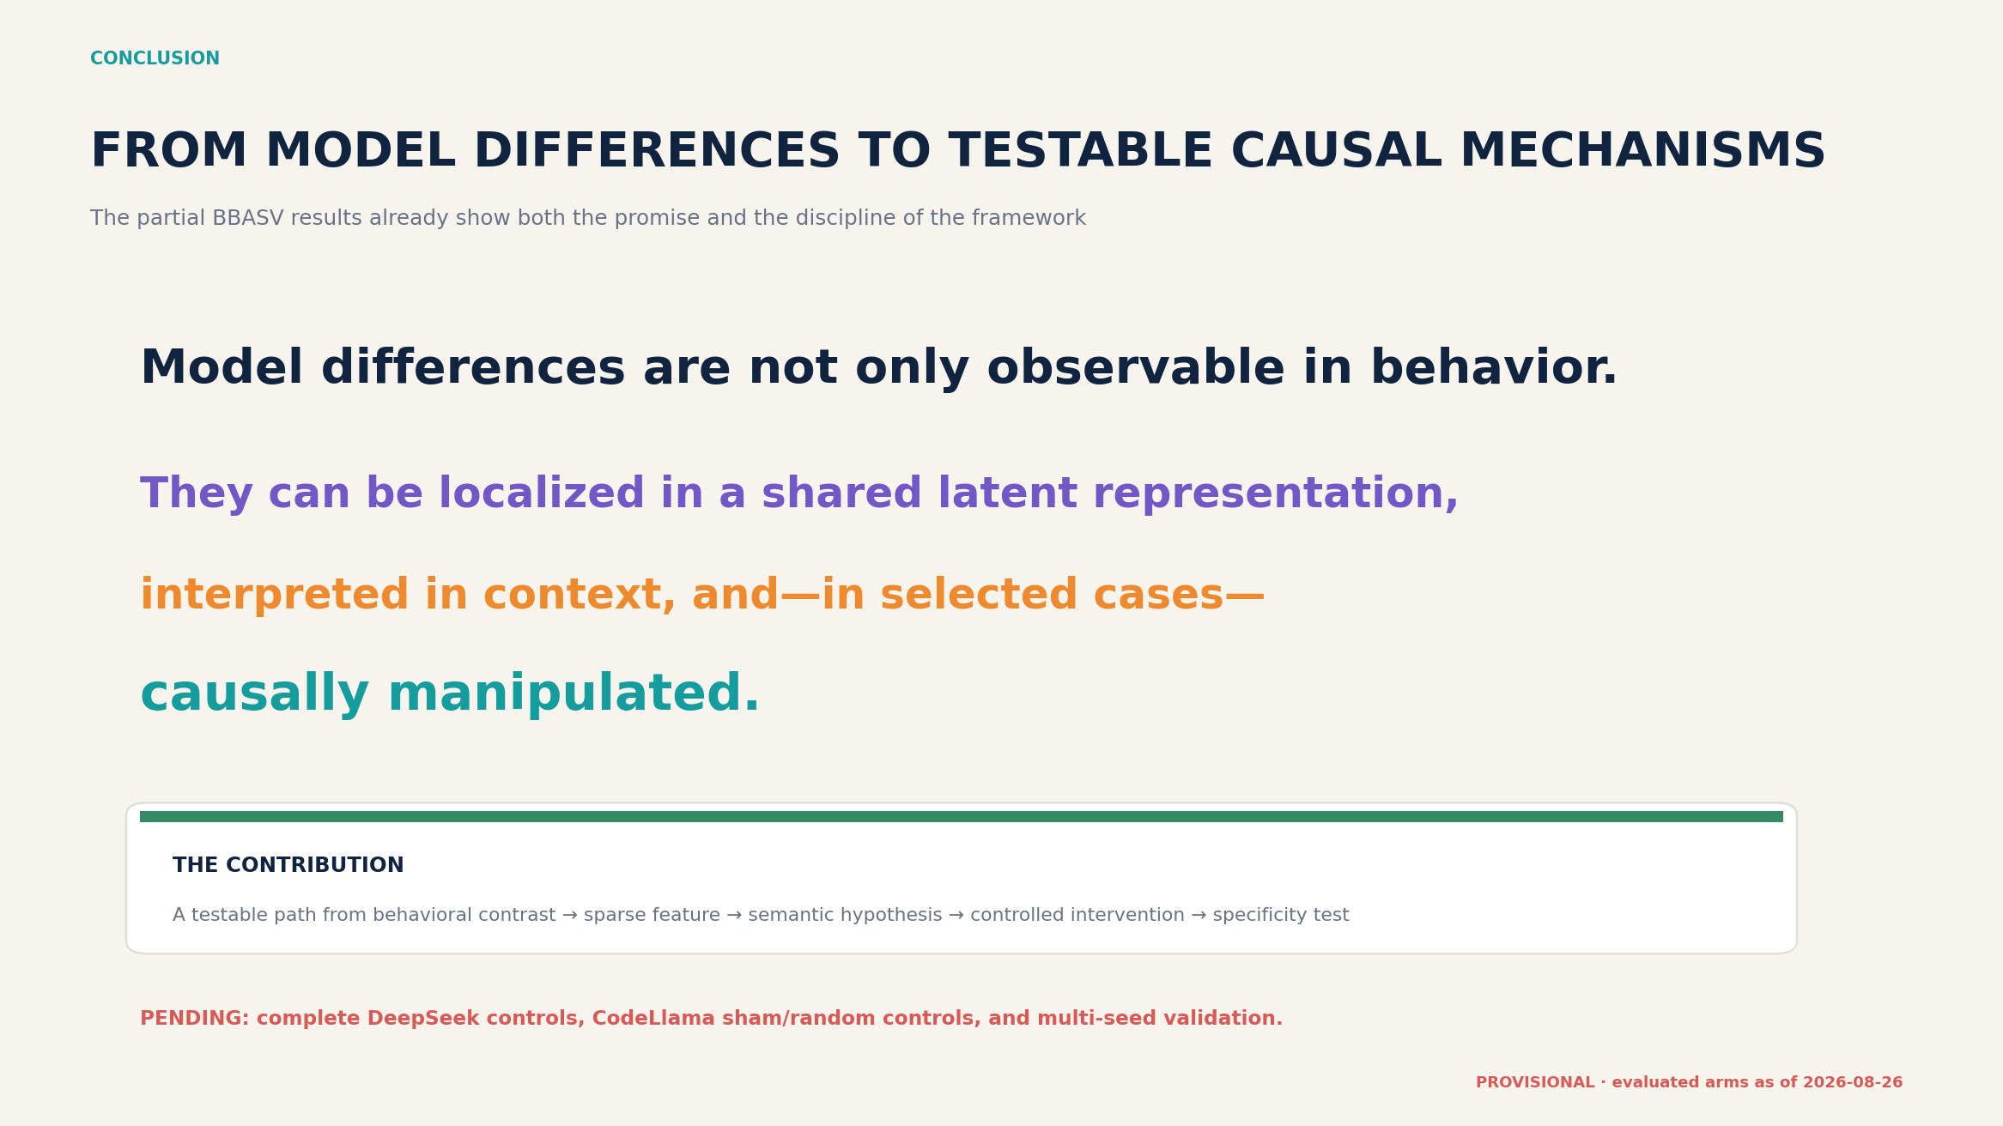
OUTDATED · superseded candidate pool and/or non-canonical seed

